Slide 1
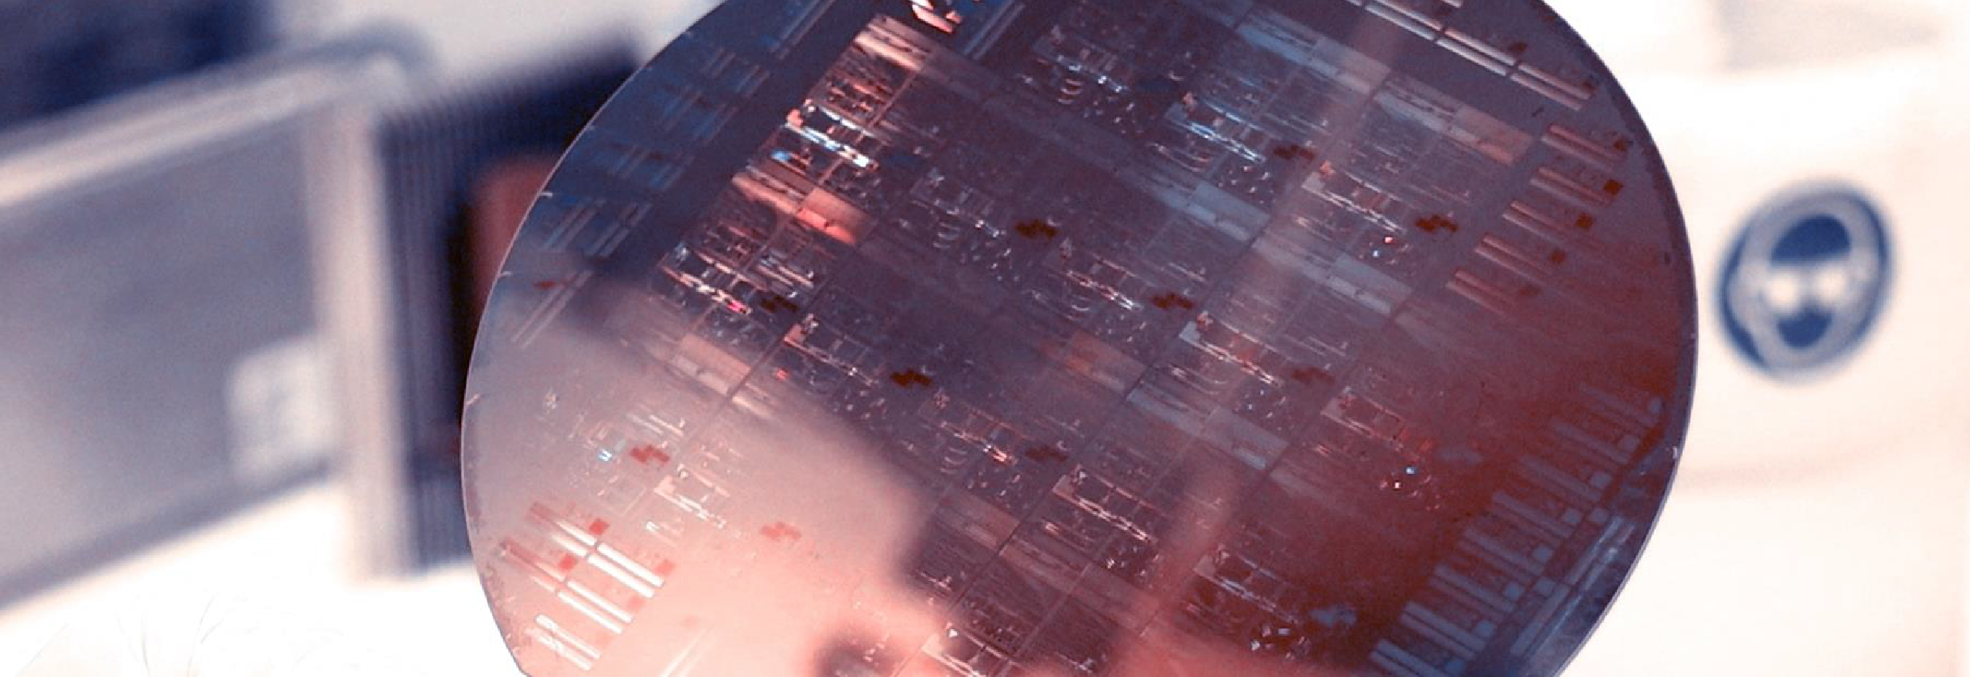
Lab Book 0.2. Couplers
Student:

Slide 2
Instructions General
SOFTWARE
Python notebook supplied by instructors
SCRIPTS
From Poliformat → download the 020_COUPLERS_v2025_Student.ipynb
Either run locally or at Google Collaboratory
Cross-Sections to be studied:
w (width)
w (width)
h
(height)
Core
Core
h
(height)
MMI Body
g
(gap)
Cladding
Cladding
Directional coupler (DC)
Multimode Interference (MMI) coupler

Slide 3

Learning outcome #1 – Directional coupler cross-section in GDSFactory
INSTRUCTOR:
Present Python and GDSFactory implementation of DC cross-section
Describe how to obtain the beating length $L_{π}$
Describe the outputs.
ALL EXAMPLE #1: waveguide width 1.2 µm, gap between waveguides 0.6 µm, deep wvg, wavelength start and end same 1.55 µm → all ”Run”
ALL: Follow instructor, that will show how to 1) plot mode, 2) explore the results (neff …)
Document all your results (neff, plot fields of different modes, comparison between different polarizations…)

Slide 4
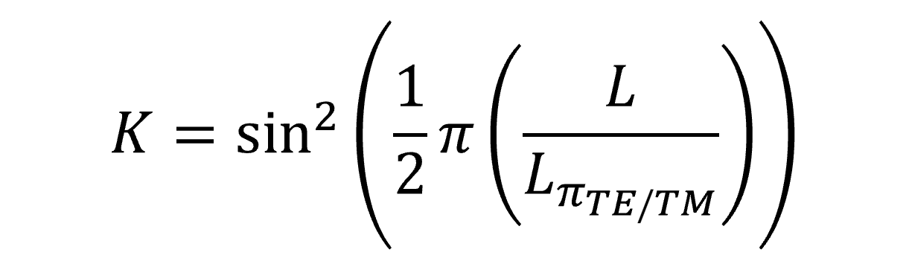
Learning outcome #2 – Directional coupler length and coupling coefficient Wavelength 1.5 µm – width 1.2 µm – gap 0.6 µm
deep waveguide
Paste L/Lpi vs K plot here
Comment results (distance needed for a complete energy transfer between waveguides, distance needed for splitting power in half.. )

Slide 5

Learning outcome #4 – Multimode Interference (MMI) Coupler cross-section
INSTRUCTOR:
Present Python and GDSFactory implementation of DC cross-section
Describe how to obtain the beating length $L_{π}$
Describe the outputs.
ALL EXAMPLE #1: waveguide width 12 µm, gap between waveguides 0.6 µm, deep wvg, wavelength start and end same 1.55 µm → all ”Run”
ALL: Follow instructor, that will show how to 1) plot mode, 2) explore the results (neff …)
Document all your results (neff, plot fields of different modes, comparison between different polarizations…)

Slide 6

Thank you

